Slide 1
Digital Frameworks
Lesson 2
Medill on the Hill
Rachel Shorey
https://github.com/rshorey/digitalframeworks-spring18

Slide 2
Final Project details
You must complete a final project for this class. The project has three components:
A 1000 word story based substantially on a dataset, due at or before 6PM on May 30 (IMPORTANT: This is the 2nd to last class!!!).
A two-minute pitch of said story, to be delivered on May 9.
In the final class, a fellow student will interview you about the piece (this is why the project needs to be turned in by May 30, so they can prepare).

Slide 3
Final project details
The 1000 word piece should answer an interesting question using data. The data component of the story must be substantial, and you need to dig into the dataset. If you just read toplines off a website without actually finding and downloading or creating a dataset, that is insufficient.

Slide 4
Final Project details
For the interview component, I’m looking for something like what CNN or NPR regularly does when they bring the author of an interesting story in to give some details. The interviewee must be prepared with 3 or 4 questions, and the interviewer needs to be prepared to go into detail about the story and the reporting behind it.

Slide 5
Final Project details
The final project is all together worth 30% of your grade. It will break down as follows:
5% for pitch
15% for written story
5% for your role as interviewer (on someone else’s topic)
5% for your role as interviewee

Slide 6
Final Project details
Examples of successful final projects from last term included:
What is floating around in the Pacific Ocean based on data from Ocean Conservancy’s international cleanup
How did skatbacks (smaller running backs) perform vs running backs as a whole, based on a dataset collected by the student
How does the number of women running for congress correlate with the number of women who vote, historically (required combining two separate datasets).

Slide 7
Data stories
You should each be prepared with at least one link to a story that relies heavily on data. In the future, I’ll call on people randomly. This week, I’m going to ask for volunteers, and then present a few I found.
Next week, everyone’s on the hot seat!

Slide 8
Data stories
https://www.washingtonpost.com/news/national/wp/2018/04/06/feature/in-reaction-to-trump-millions-of-americans-are-joining-protests-and-getting-political
https://www.houstonchronicle.com/news/houston-texas/houston/article/Texas-pregnancy-related-deaths-inflated-finds-12819264.php
https://www.washingtonpost.com/graphics/2018/politics/superpac-donors-2018
Notes:
Wapo on rallygoers. I dislike the percent chart with the blown up people because it’s totally perceptually inaccurate. Also I still have the question: is this different? Maybe these numbers are totally consistent over time (or every time an administration switches). It feels like they tried to address it with the 20% new rallygoers stat, but I’m still not convinced THAT hasn’t always been true. Maybe the rally stats are exactly the same as during the Obama years, the cast just changed.

Slide 9
“Hey, I heard the local government just released a big data dump, can you find a story?” --your editor
Notes:
This is (often) a recipe for a bad data story.

Slide 10
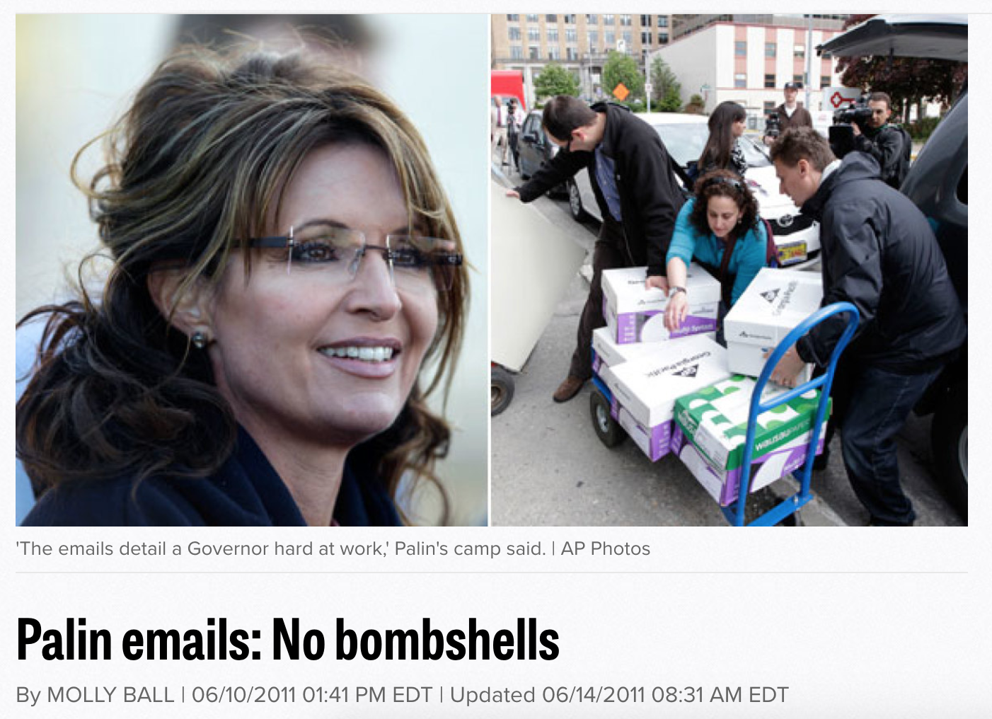
Notes:
This is a document dump, not a data dump, but the idea is the same. Just because the data is there, doesn’t mean there’s a story.
I don’t really begrudge them this story - people knew the emails came out, so it was important to say that nothing was in there on the record, imo. But assuming there’s a story in a data or document dump is often wrong. Especially if you’re trying to do it on deadline.

Slide 11
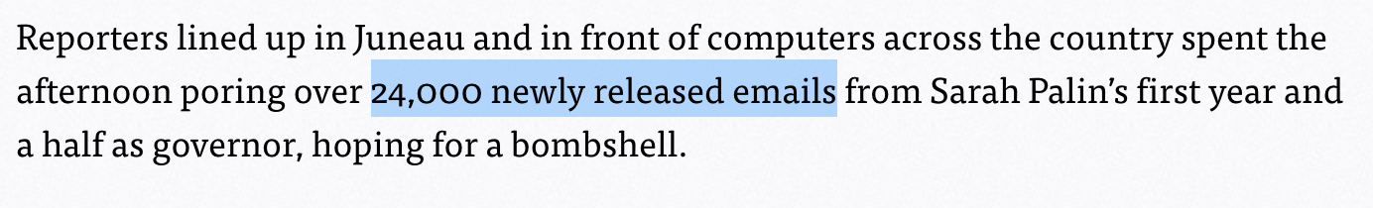
Notes:
A good indication of an on-deadline, we-felt-obliged-to-write-this-story non-story? The size of the dataset is in the lead.

Slide 12

So how DO you write a data story?
Notes:
Start with a question! Then find the data to answer it.

Slide 13
How a question becomes a story
I wonder how politics are impacting the NFL?

Slide 14

How a question becomes a story
It’s late January. The Super Bowl is coming up.

Slide 15
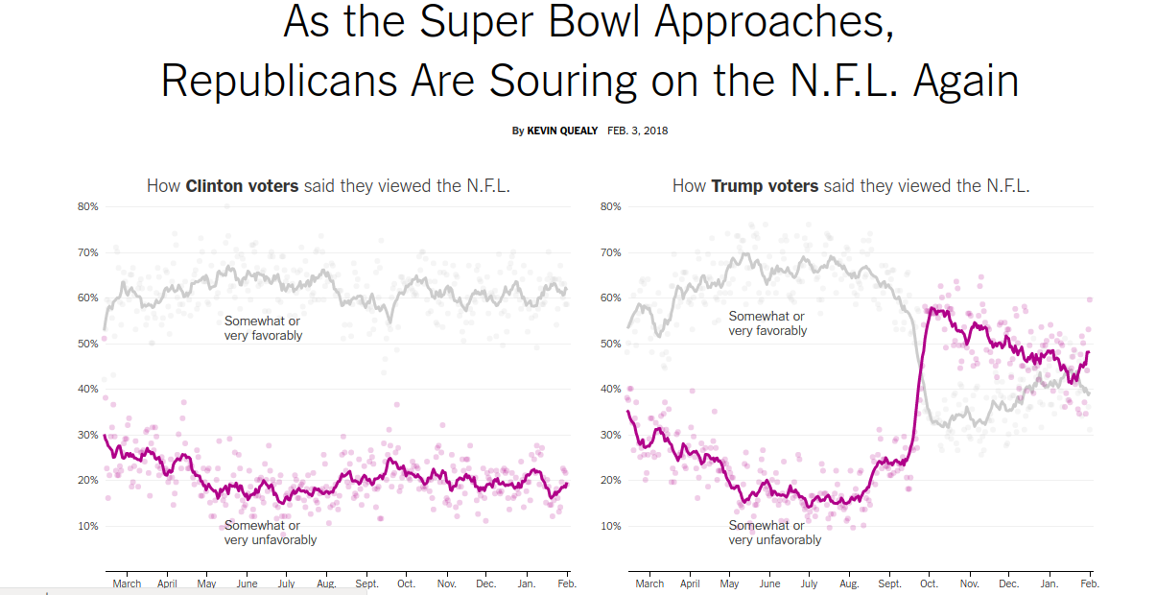
How a question becomes a story
Notes:
The story then goes into some detail of why the R line is so jumpy, citing studies about how long people remember persuasive messages for, etc.

Slide 16
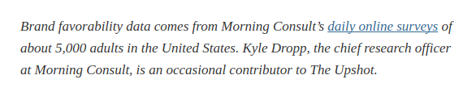
How a question becomes a story
Notes:
This is the description of the dataset at the bottom of the story. The reporter decided to answer his question by seeking out related data (sometimes when you do this, like in any reporting, you find out you don’t have a story, but here he did). In this case the data was quite easy to find - the upshot had a contributor who could just hand it over.

Slide 17
How does a question become a story?
Winter seems warm here. I wonder what parts of the US are seeing the most winter warming as a result of climate change?

Slide 18
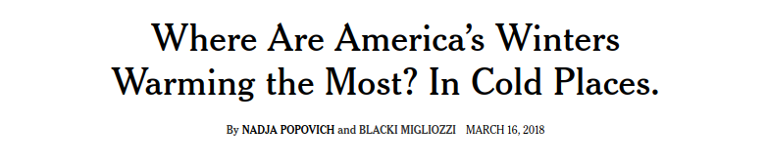

Slide 19
Government data: a great place to look!

Slide 20
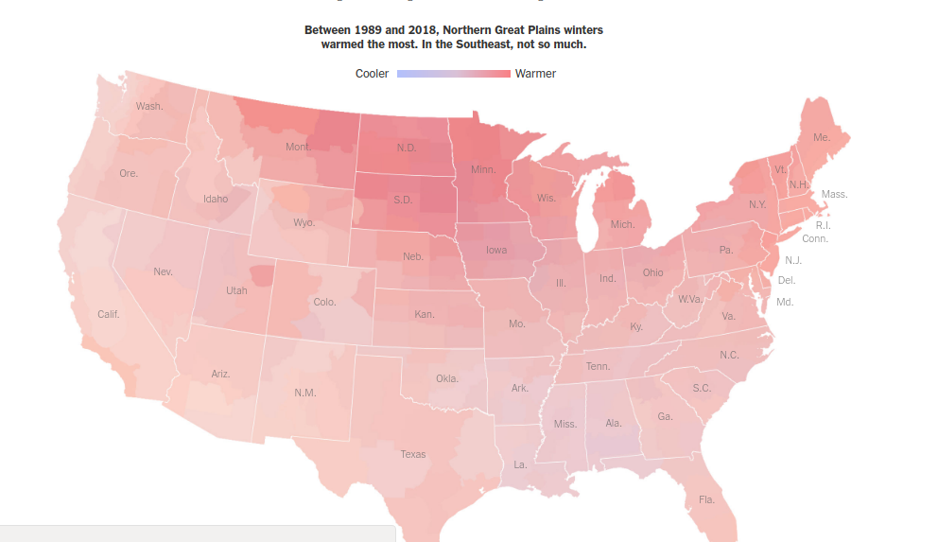

Slide 21
How does a question become a story?
Who is the US actually holding in Gitmo?

Slide 22
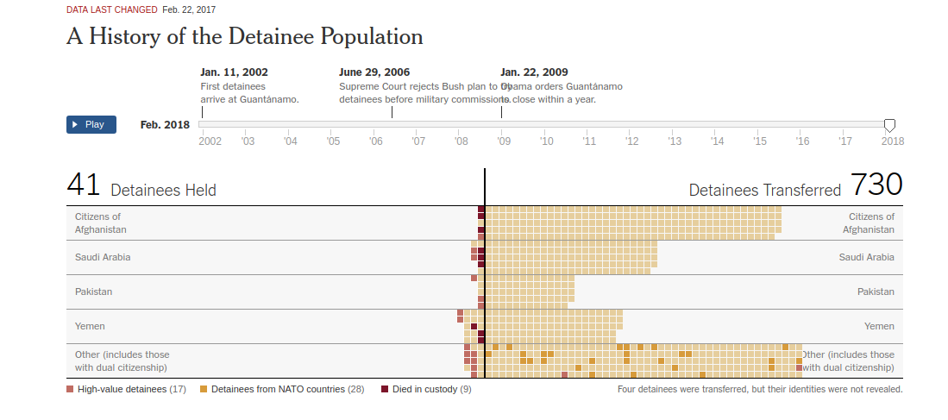
Who is being detained at Guantanamo Bay?
Notes:
This is one of (and possible _the_) oldest app getting ongoing maintenance at the NYT. You’ll note the overlapping text and generally old design.

Slide 23
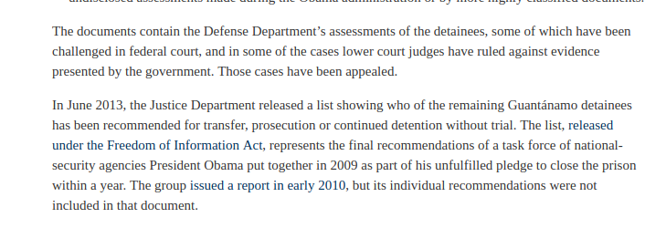
Gitmo data
Notes:
The data came from digging through court documents and filing FOIAs, and then manually converting those documents into the numbers and updates you see in the graphic.
Funny story: given when the code was written, there is actually no way in the app to add someone to gitmo. My colleage Jeremy Bowers maintains the app (he inherited it from 2 previous maintainers), and every time he sees our two reporters who have covered gitmo chatting, he gets a little nervous.

Slide 24
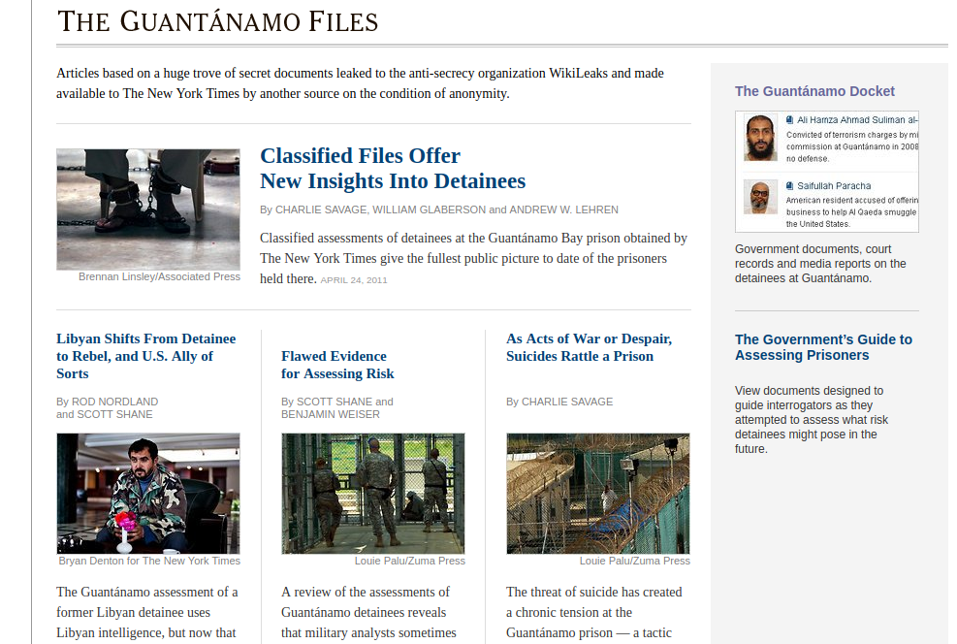
Notes:
Gitmo data didn’t just turn into one graphic, it powered dozens of stories about the detainees, the process, etc.

Slide 25
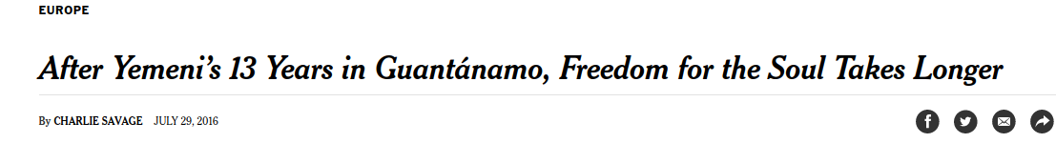
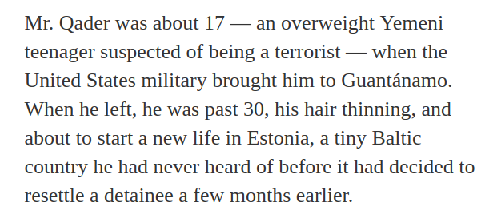
Notes:
And the stories didn’t stop in the Gitmo heyday. This is from a much more recent story. Charlie Savage has been watching this data for so long. He noticed it seemed odd that a yemeni detainee had been transferred to Estonia. So he looked him up and got him on the record.

Slide 26
How does a question become a story?
How many people die as a result of police shootings in the US?

Slide 27
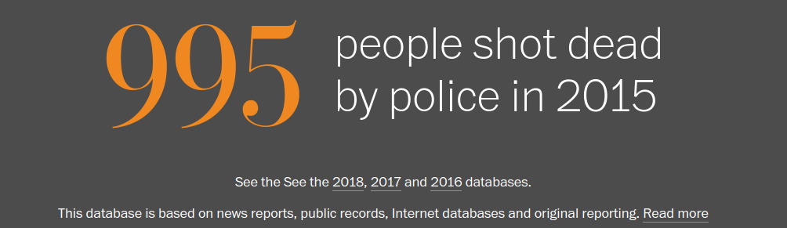
Turning a question into a Pulitzer

Slide 28
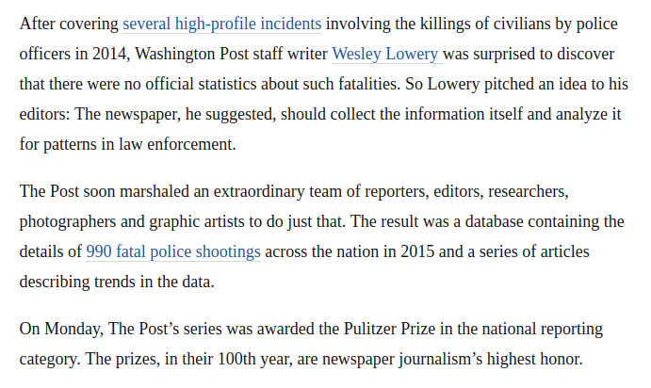

Slide 29

Notes:
This is the guy who gets most of the data. Here he is in his own words.

Slide 30
How do you ask a good question of a dataset?
It needs to be answerable with data.
Questions that start with “how many” or “what is the most/least” tend to be good starting points
Precision is important. For example, if you’re going to ask a “where” question, decide whether you care about cities, counties, states, etc.
The answer leads to more questions you can determine through reporting or additional data.

Slide 31

Example
Which ward in DC has the most spray parks?
Notes:
*It is answerable with data - I just have to figure out who has the list!
*It is precise. I’ve defined my question in terms of wards, and I know that most DC data is broken up by ward.
*It gives me the opportunity for more questions - if I find that some wards have more than others, is that because they are larger in area? Have more people (esp more kids)? Do the ones with fewer spray parks have more of other similar things, like pools? Does spray park distribution correlate with income?
We’ll look at how we solve some of these questions below.

Slide 32
So you’ve got a question.
Let’s find some data. We need a data source…
That can answer our question
That is trustworthy
That is objective
That is verifiable
Notes:
Obviously we want a data source that will have the answer to our question. It’s important to try to figure this out before investing a lot of time in the data source.
By trustworthy, I mean the entity that provides it has a reason to have the data and know it’s accurate, or has a reputation of doing so.
Does the data source really need to be objective? I guess it depends a little on what question you’re asking. For example, it is very easy to ask biased poll questions. “Do you support medicare for all ” vs “should we raise taxes in order to subsidize healthcare for people who can’t afford it?” So maybe objectivity isn’t exactly the right word, but we want any potentially biasing information to be disclosed.
When you publish an analysis or graphic based on data, people will ask questions. You probably are going to need to be able to say more than “just trust me”. If it’s a public or publishable dataset, that’s helpful. If not, you’re going to have to rely on other sources or the reputation of the holder of the data.

Slide 33
Data source example
A question: How many people in North Carolina changed their vote from Barack Obama in 2008 to Mitt Romney in 2012?
Notes:
Perhaps you remember that Obama won NC in 2008, but Romney won in 2012?

Slide 34
Data source example
I’ve found a nice dataset! North Carolina publishes voter history information for all voters!
(Most states do, although in many states you have to pay. In NC it’s free!)

Slide 35
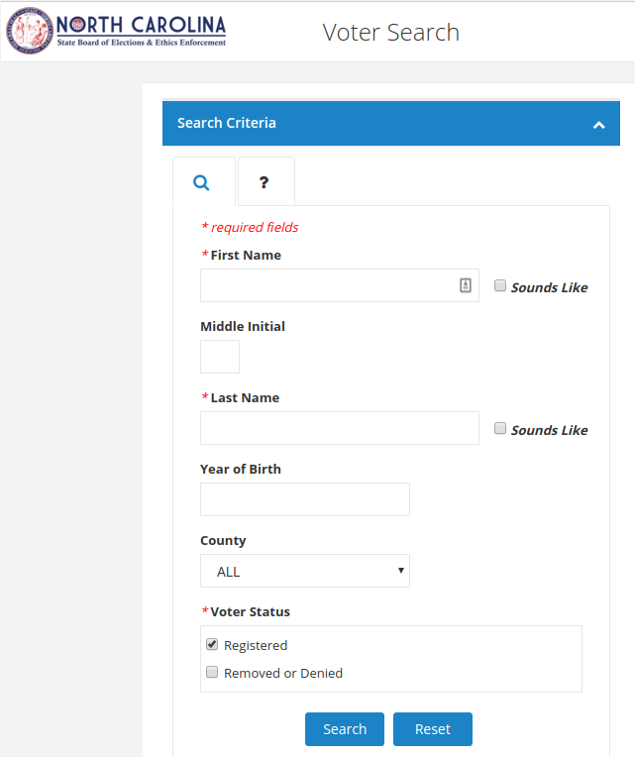
Data source example

Slide 36
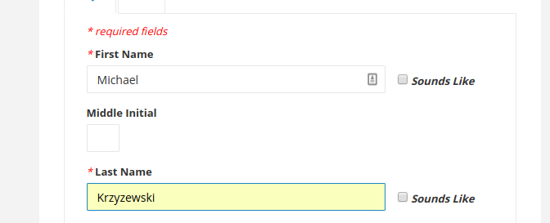
Data source example
Notes:
Anyone know who this is? Where are the sports fans?

Slide 37
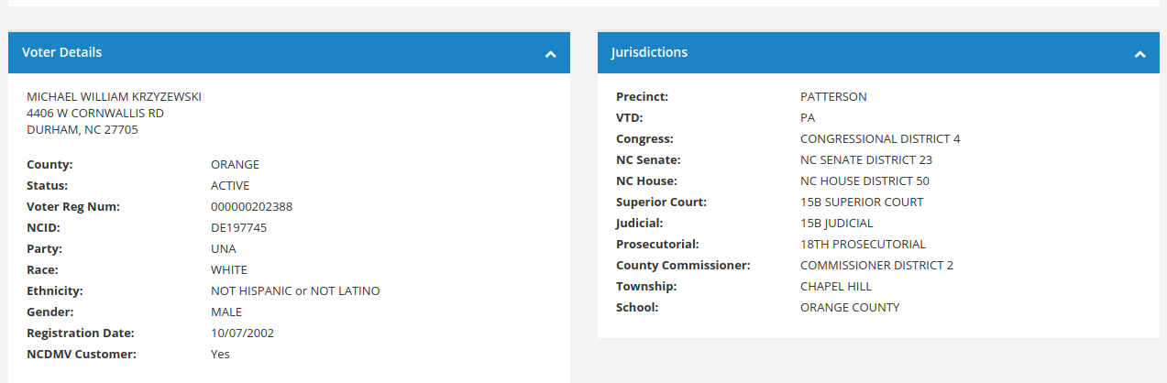
Data source example
Notes:
I can find out a lot about him. And thankfully, the whole dataset is downloadable, so I can find this information about every NC voter, not only coach K, without running through this search.

Slide 38
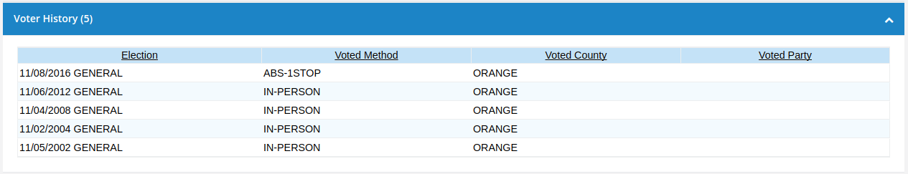
Data source example
Notes:
Here’s coach K’s voting history. So.
Is this dataset trustworthy? Well, it’s provided by the NC secretary of state, and they’re in a position to know.
Is it objective? Yes, it’s just a factual list of voting information.
Is it verifiable? Yes, anyone could do exactly what I did.
Just one problem. It doesn’t answer our question. In the US, your vote history is public. But that means when/whether you voted. Not who you voted for. If you want to know that, you’ve got to find a different (and possibly less trustworthy/objective) dataset.

Slide 39
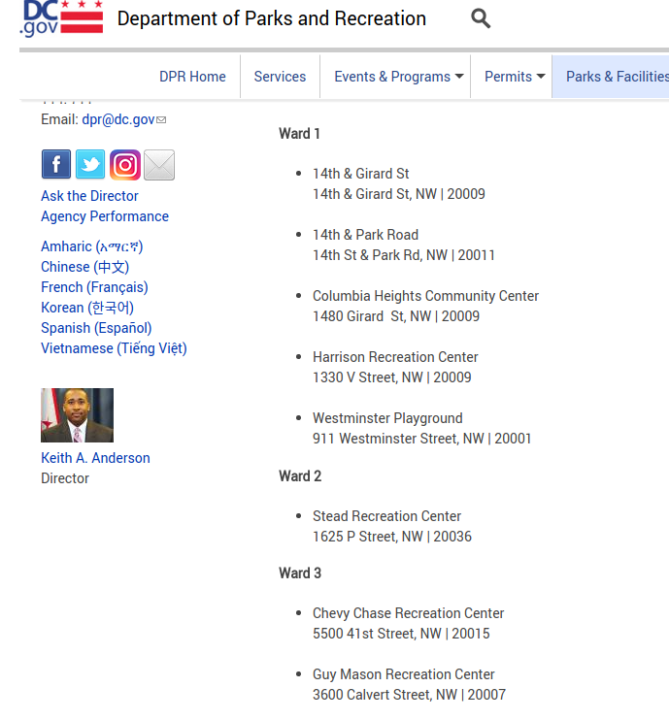
Back to DC spray parks
Notes:
I’ve found a dataset. What do we think about it?
*It will answer my question about spray park by ward
*It is provided by DC government’s department of parks and recreation, they maintain the facilities, so they ought to know
*Is it objective? Yes, it’s just a list. Although if there are spray parks that are privately owned, it might have chosen not to include them in the dataset. This would be a good place to look while turning this into a story!
*Is it verifiable? Yep, it’s right there on their website.

Slide 40
Finding trustworthy, objective data
Governments are usually a good starting point
(although data collection can be political, so be careful!)
Notes:
Eg census, gold standard data, right? May I direct your attention to the current question about whether to ask a citizenship question.

Slide 41
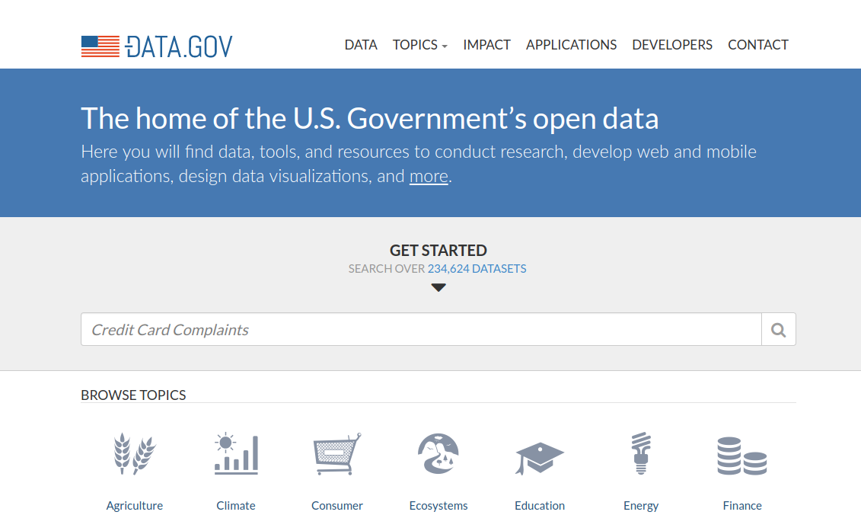
Notes:
Data.gov is a portal for government datasets. They don’t collect the data, they just point you at existing datasets collected and hosted elsewhere.
Many cities and states are starting to have portals like this. Most of them are a lot messier. Best is probably to google the name of your city and “open data portal”

Slide 42
Think tanks, research organizations, journalists
If you read a study or story about a dataset, the data is often publicly available. If it isn’t (or isn’t clear exactly where it is or what data they used) you should ask! Just be sure to confirm there isn’t a statement about where they got their data in the story.

Slide 43
Want a fun and quirky dataset?
There are lots! And Jeremy Singer-Vine, the data editor at Buzzfeed, really loves public data. So he writes a newsletter about available datasets with commentary every week, called Data is Plural.
And he’s made the whole archive into a public data set. Meta.
Notes:
My favorite dataset I have learned about from this newsletter is the list of things that have been lost on the subway in NYC. If you could track down any of the 9 people who have outstanding lost answering machines on the MTA, I would read that story.

Slide 44
Example of vetting a dataset
Slides from Alberto Cairo: https://www.urban.org/sites/default/files/jan_26_2018_washingtondc.pdf
Notes:
So you’ve found a dataset that will answer your question. How do you confirm it is objective, trustworthy and verifiable?

Slide 45
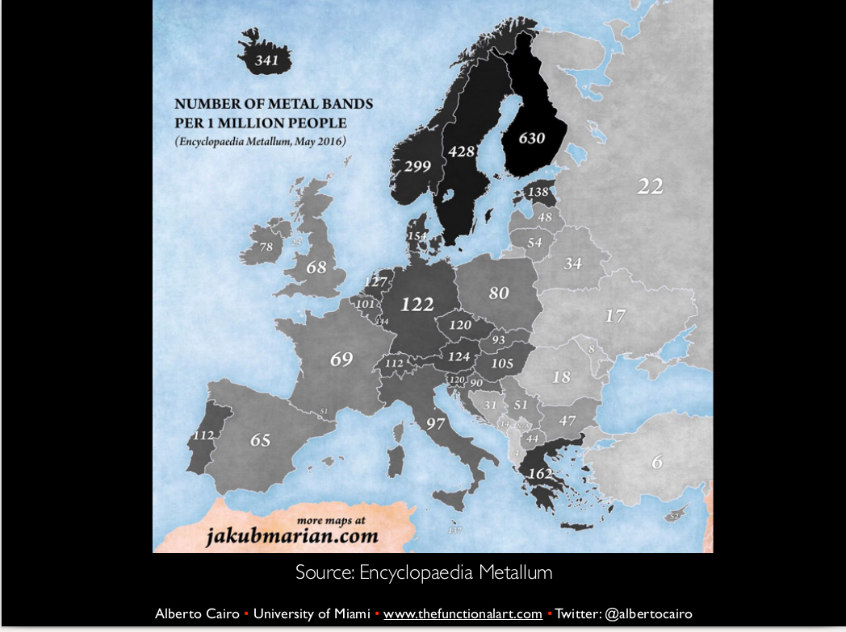
Notes:
Sometimes the best way to vet a dataset is to take a look at it. Here’s an example of a map Alberto saw. He wanted to confirm it was reasonable. Thankfully the source of the data is listed on the map. Alberto is a metal fan. He knows that people often classify very non-metal groups as metal. So what is a metal group?

Slide 46

Notes:
According to Alberto, Judas Priest is the metalest.

Slide 47
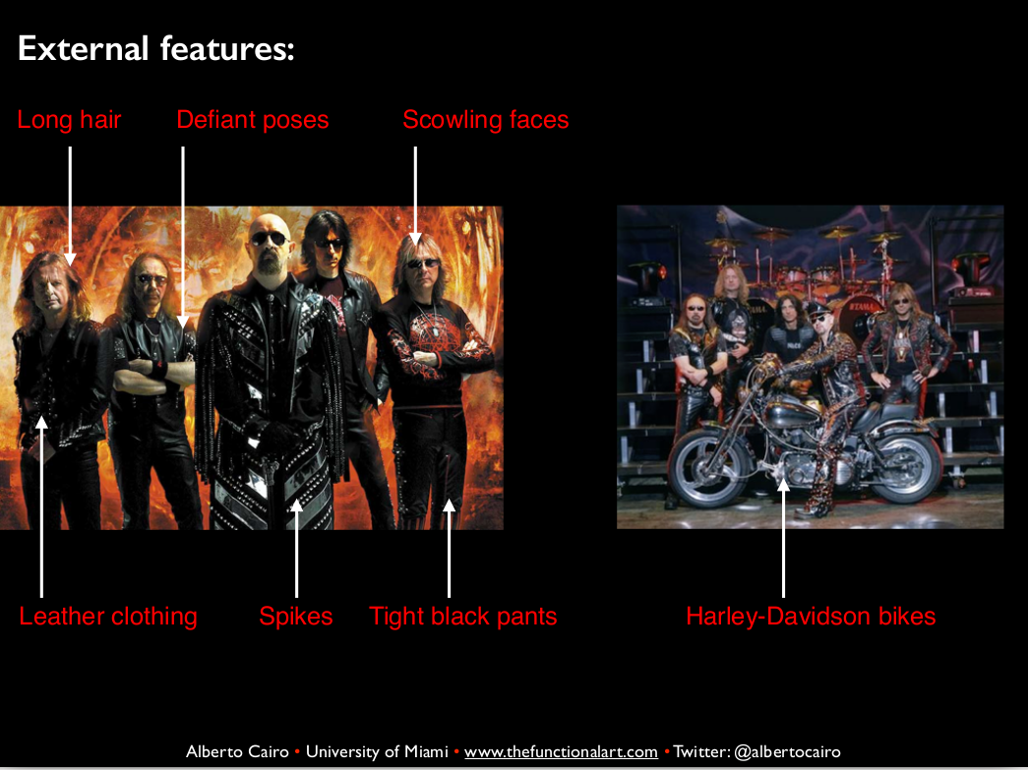
Notes:
Judas priest. Metal.

Slide 48
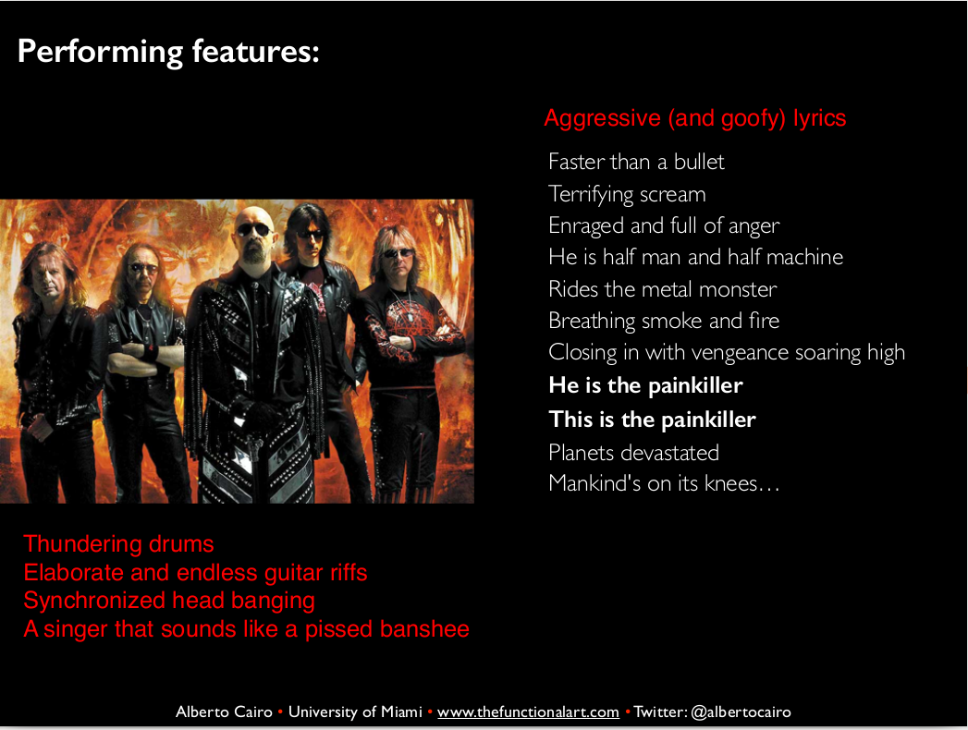
Notes:
Really, really metal.

Slide 49
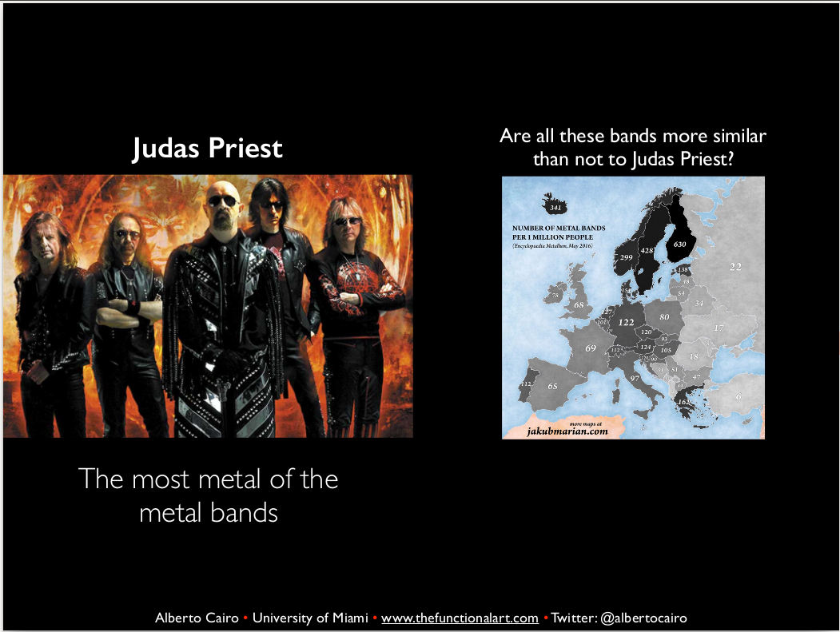
Notes:
So, are the bands in this chart like known metal bands? Or are they like other non-metal bands that are sometimes classified as metal?

Slide 50

Notes:
Alberto thankfully knows a lot about nonmetal bands that people call metal. Here are a few bands that are often called “metal” even though they are NOT (according to Alberto) metal.

Slide 51
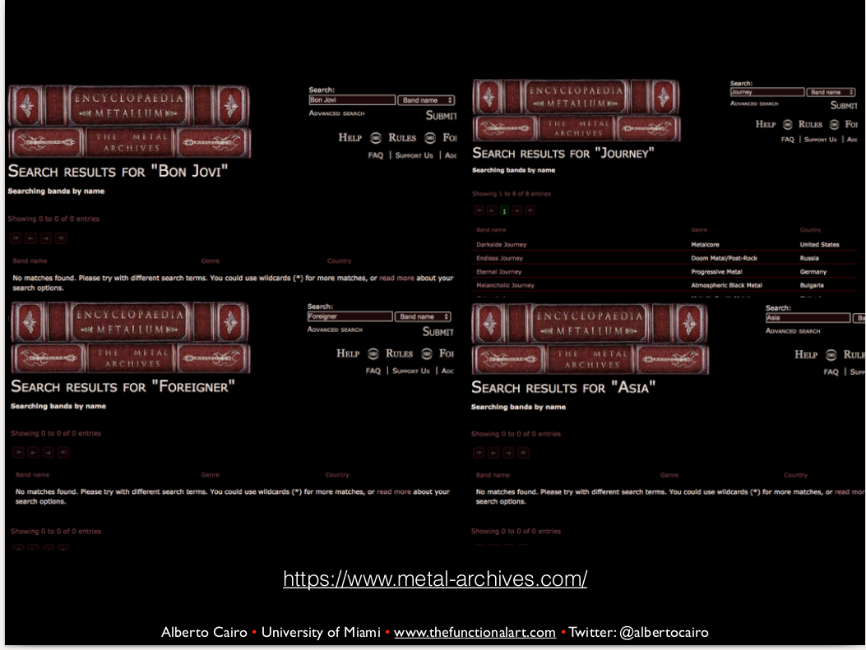
Notes:
So, what does the dataset say? None of the non-metal bands appear in the encyclopaedia metallum. That doesn’t mean this dataset is entirely trustworthy, but it’s a good trust signal. Alberto felt comfortable sharing the map, and would consider using this dataset himself.

Slide 52
Dataset vetting
Get the data about the data
Who created it?
Who is responsible for maintaining it?
What point in time or time-range does it apply to?
How was the data collected?
How was the data processed after being collected?
How was each field collected or calculated?
(from David Eads of ProPublica, IL)
http://training.npr.org/visual/what-to-do-with-a-big-pile-of-data/

Slide 53
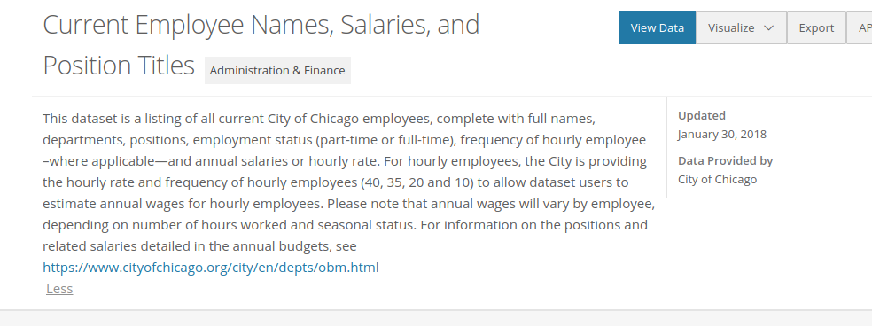
Vetting a dataset: example
https://data.cityofchicago.org/Administration-Finance/Current-Employee-Names-Salaries-and-Position-Title/xzkq-xp2w
Notes:
Here’s a dataset description (and URL). What can we determine? (continued on next slide)

Slide 54
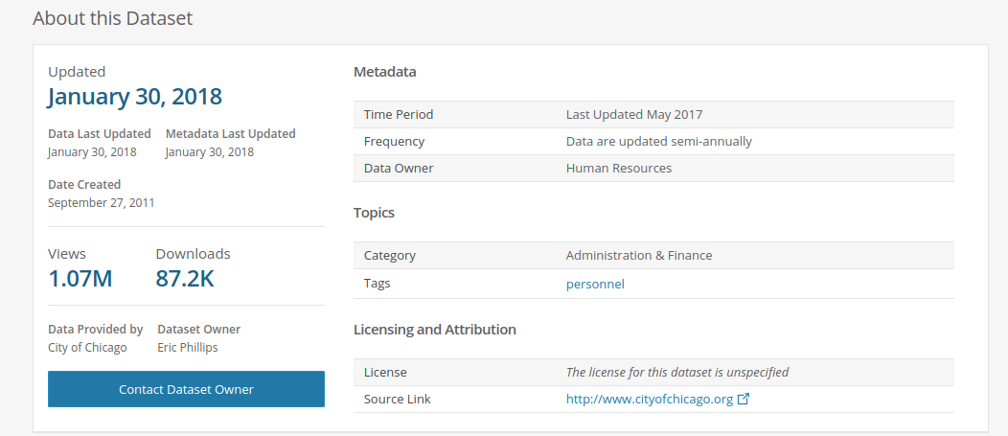

Slide 55
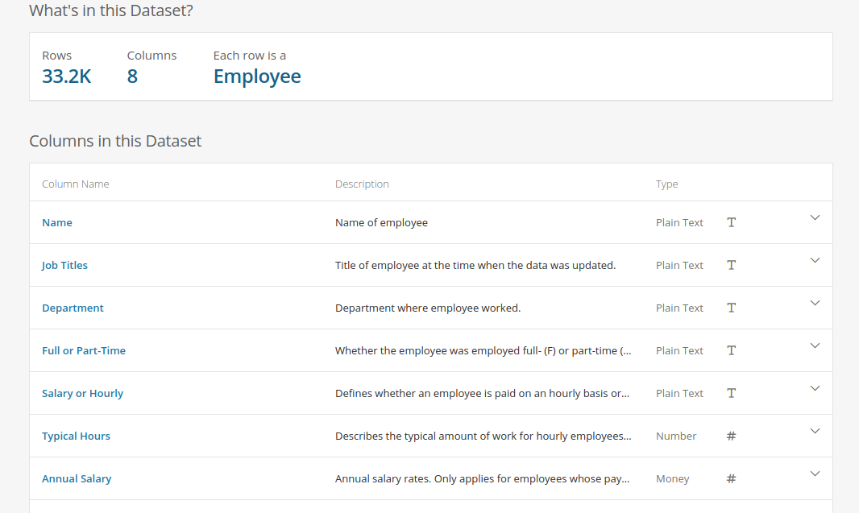

Slide 56
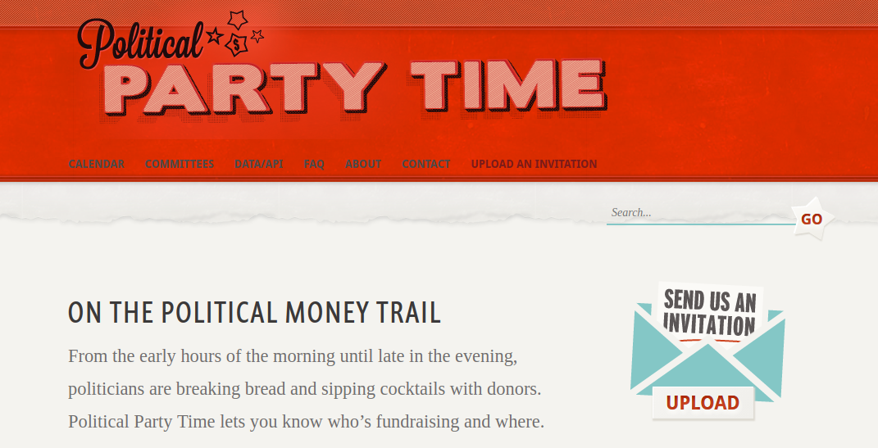
http://politicalpartytime.org

Slide 57
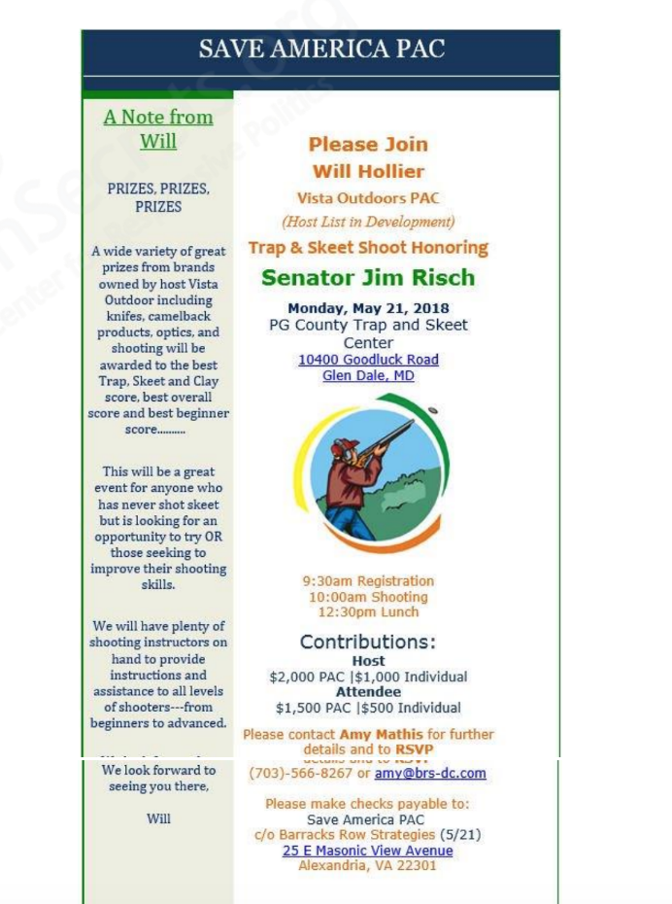

Slide 58
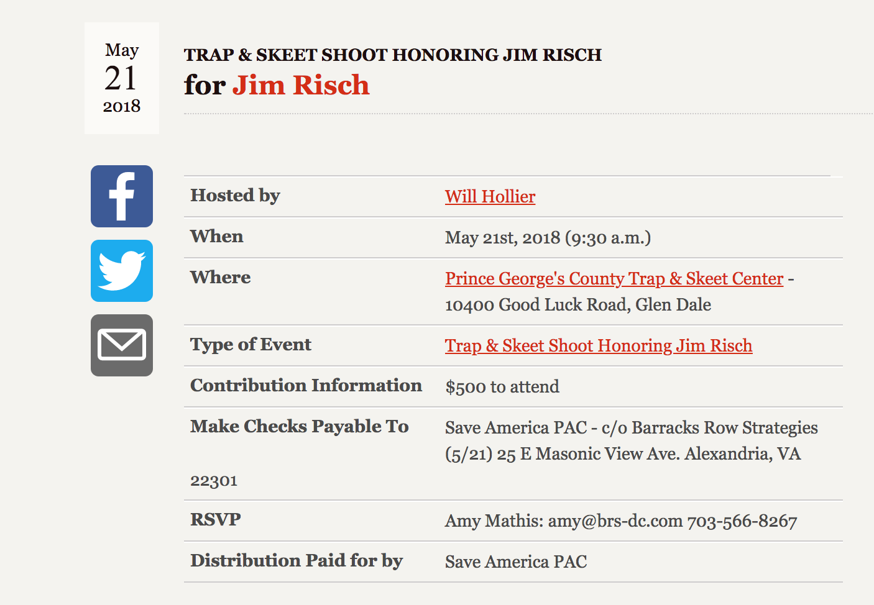

Slide 59
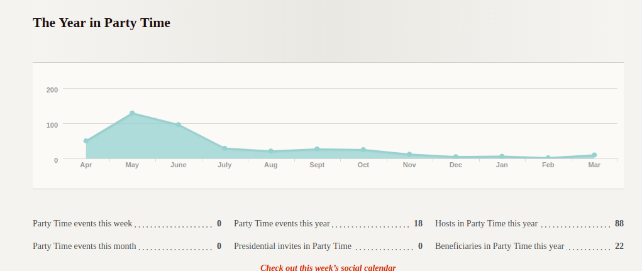

Slide 60
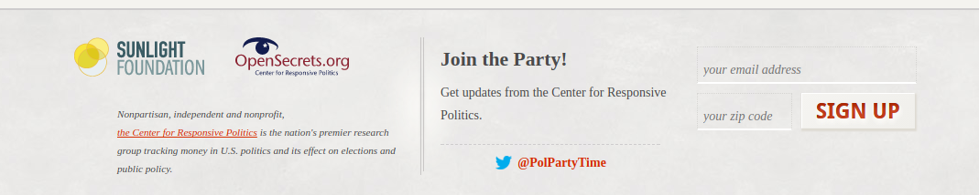

Slide 61
What next?
Open the data (excel or google sheets is a good place to start for many datasets)
Look for the unexpected:
Is the data what it claims to be?
Does it contain known data points?
Is there obvious missing data (eg data for 2014, 2015 and 2017?)
Are there outliers that could be errors?
Sort the data from biggest to smallest and then smallest to biggest on several columns
Does the data actually answer your question?
Notes:
There is such a thing as too-good-to-be-true datasets - eg the other day someone sent me a database of what I thought was all state level campaign finance reports. Turns out it was actually a database of campaign finance LAWS which is interesting, but not really what I thought.
If your data is city salaries, does it contain the mayor? How about your aunt who works at the DMV?
X
People who look at campaign finance fundraising often get really excited when they see this one candidate who claims to have given himself hundreds of millions of dollars. Turns out those are “in-kind services”, meaning he just performed services of, he claims, $900M in value. Those services involve investigating the crimes and coverup FBI, CIA and other branches of the US government.

Slide 62
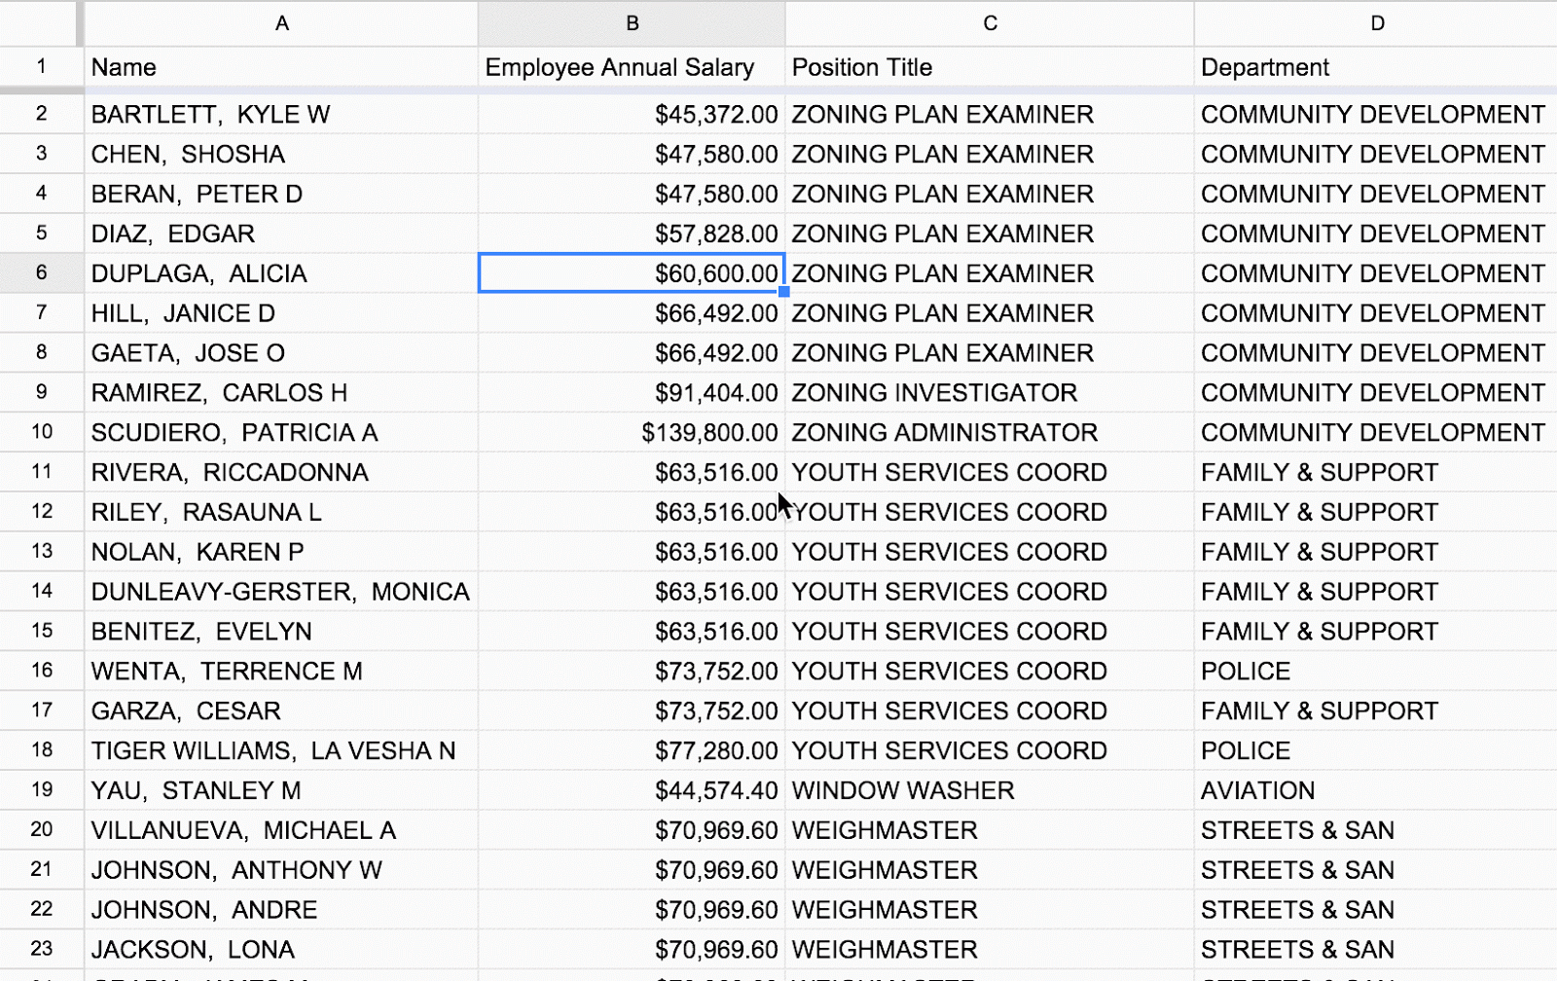
Notes:
So what’s with this guy making $.96? Will definitely require some investigating. Probably worth starting with a google.

Slide 63

The best tool in vetting a dataset
Notes:
We can poke around. And we should. But if we don’t know how the data was collected, and why, and by whom, we are at risk of misrepresenting it. If something is confusing or unclear, do what you would do with any source: confirm, and then if necessary confirm with another source.

Slide 64
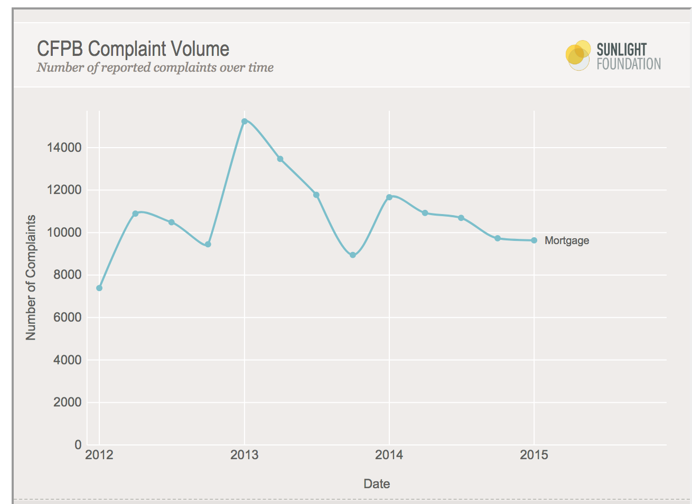
https://sunlightfoundation.com/2015/07/14/cfpb-releases-new-database-of-consumer-complaints/
Notes:
This is from a story I wrote for the Sunlight Foundation in 2015. I spent a lot of time trying to tell a story about why mortgage complaints had spiked in 2013 and then come down.
Guesses?
Mortgage rates hit a record low in 2012. My best guess was that when the went back up again in 2013, people with adjustable rate mortgages started having problems, but then things sort of settled down?

Slide 65
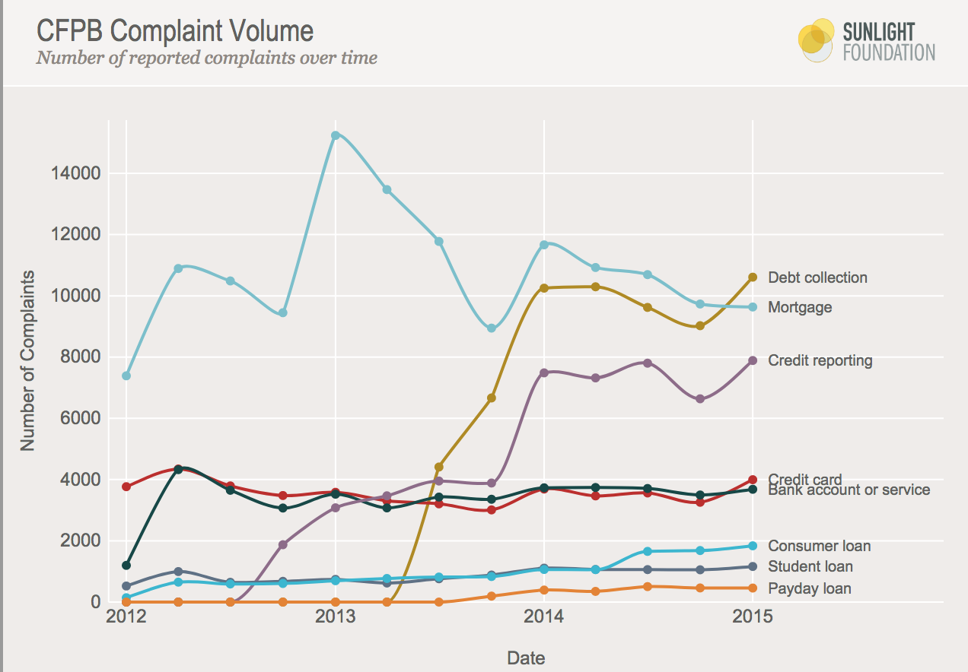
https://sunlightfoundation.com/2015/07/14/cfpb-releases-new-database-of-consumer-complaints/
Notes:
It turns out I was entirely wrong. The rate of complaints probably went up as people learned about the tool and started complaining. The reason they went down is that the term “debt collection” was added as an option. The most likely answer is that many of those complaints were actually about debt collection on mortgages. So the data we’re seeing is an artifact of how it was collected. This is important given a conversation we had last week about how the census is going to change their race/ethnicity categories, by, among other things, adding middle eastern. People who have previously been reporting a different race (eg white) might now report middle eastern. A bad analysis might suggest that the US is getting less white (as we know it is, unrelated to this change) but good analysis needs to take into account the different options.

Slide 66
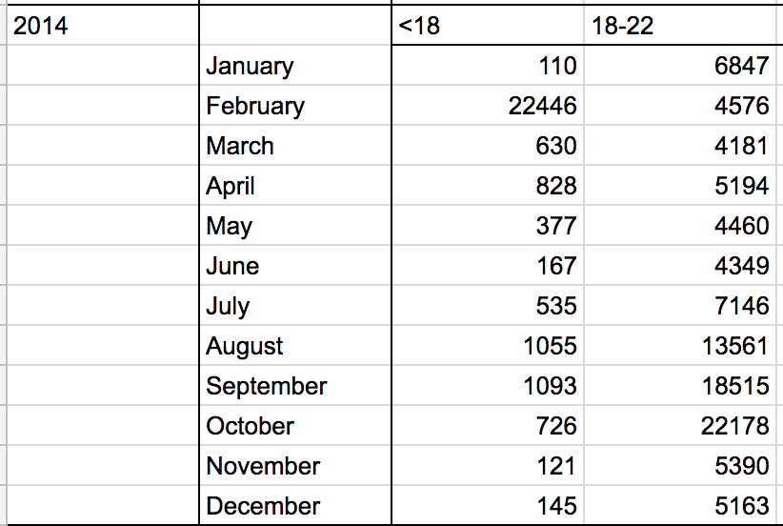
Even government datasets need to be vetted!
I recently got this data from a state government. It is new voter registrations by age.
Notes:
First I did some research about whether anything major happened in NC in Jan/Feb 2014. Then I picked up the phone and called the person who provided me the data. He told me there was a “law change” in 2014. I tried to find the relevant law change, but the only change I can find made voting MORE restrictive. I suspect there’s an error in here, and I’m not using the data.

Slide 67
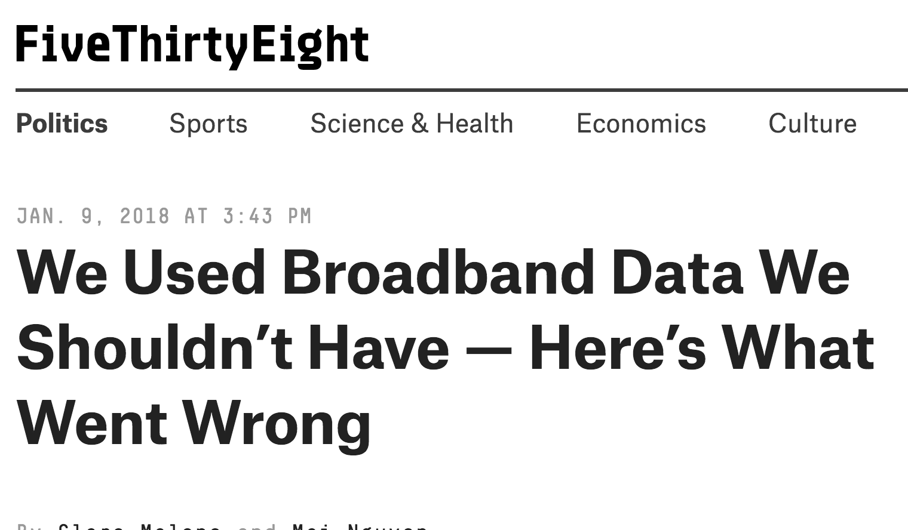
Notes:
I don’t want to pick on 538, really. They are very honest about their mistakes and not making them again, so they make for a very good instructional example.

Slide 68
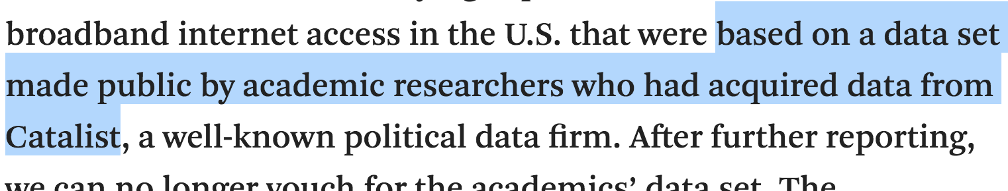
Notes:
The data was second hand.

Slide 69
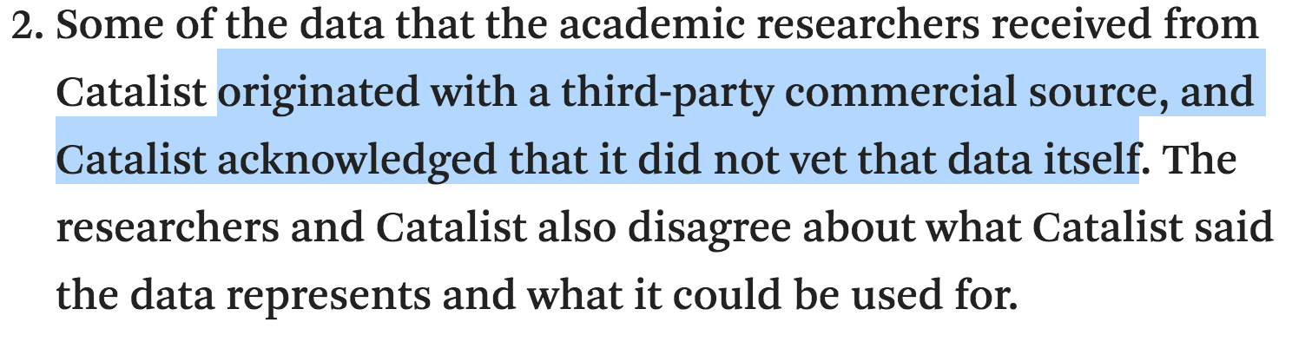
Notes:
Actually third-hand

Slide 70
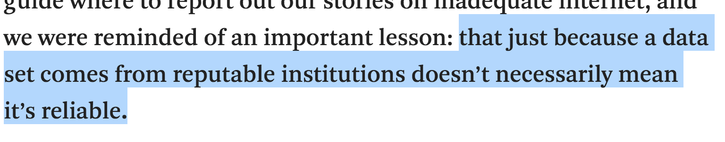
https://fivethirtyeight.com/features/we-used-broadband-data-we-shouldnt-have-heres-what-went-wrong/
Notes:
They go into a very thorough examination of the dataset in the article.

Slide 71
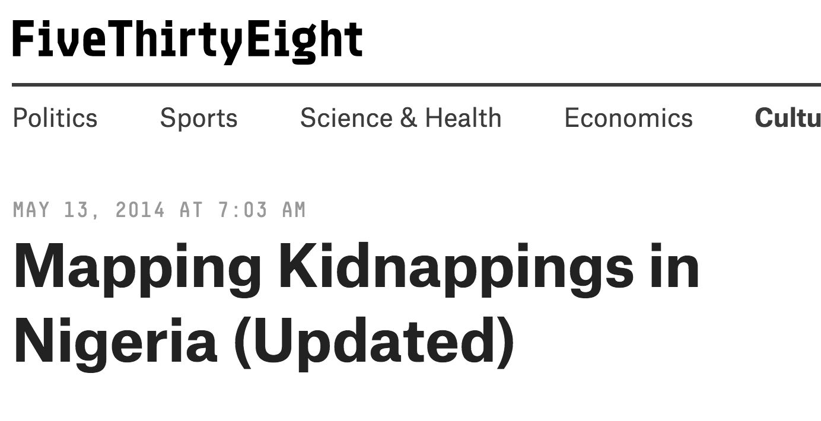
Notes:
As noted, I don’t really want to pick on 538, but they do a lot of data stuff and they are honest with their mistakes.

Slide 72
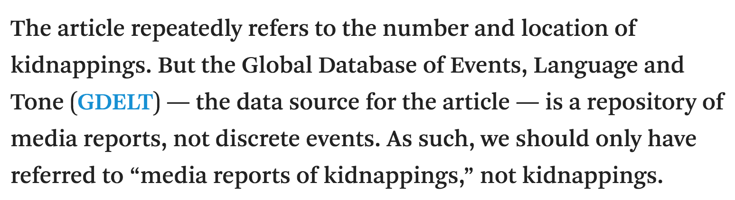

Slide 73
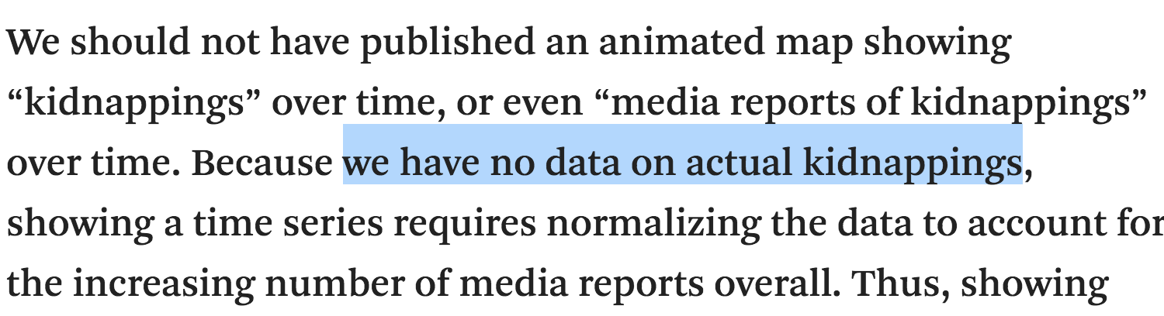

Slide 74
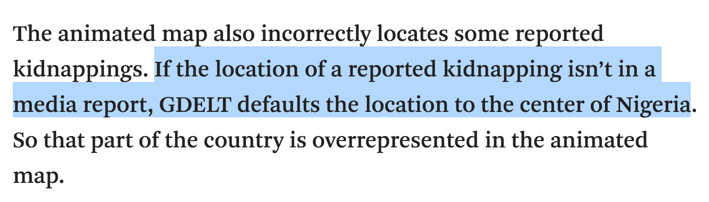
Notes:
This is a very good example of a bad data omission - if something is defaulting to zero (or a consistent number) that is bad.

Slide 75
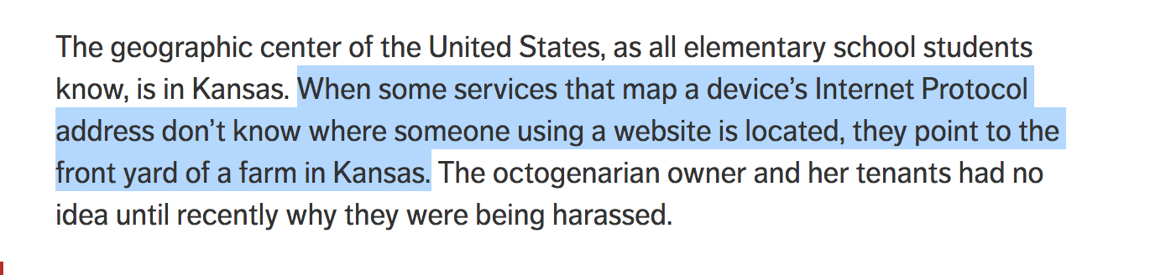
https://consumerist.com/2016/04/11/this-farm-in-kansas-is-the-default-address-for-all-american-internet-users/
Notes:
If everything’s coming up kansas, something is wrong with your data

Slide 76

Notes:
Similarly, if you find a lot of stuff happening in the ocean off the coast of Africa, your dataset probably had lat/log set to zero.

Slide 77
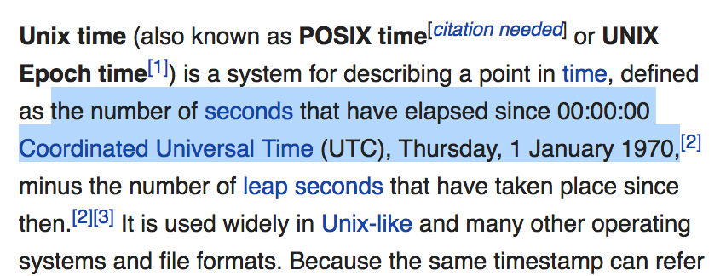
Notes:
TANGENT: other telltale bad numbers
Many programming languages think the beginning of time is Jan 1, 1970. If you see this date a lot in your dataset, there’s probably a problem (same for any very common start date, because different data entry systems might have different defaults)

Slide 78
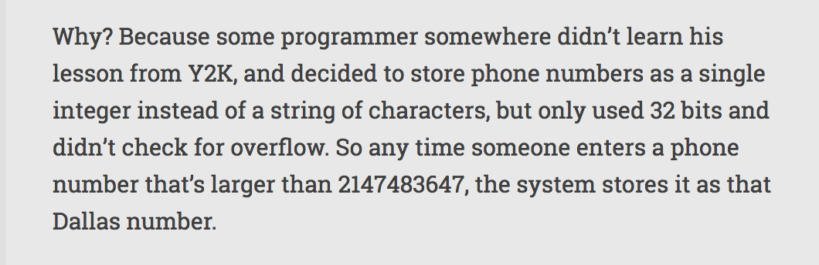
The most common phone number: 214-748-3647
Notes:
In this scenario, any number bigger than 2147483647 is turned into that number. (I have called this number, no one picked up)

Slide 79
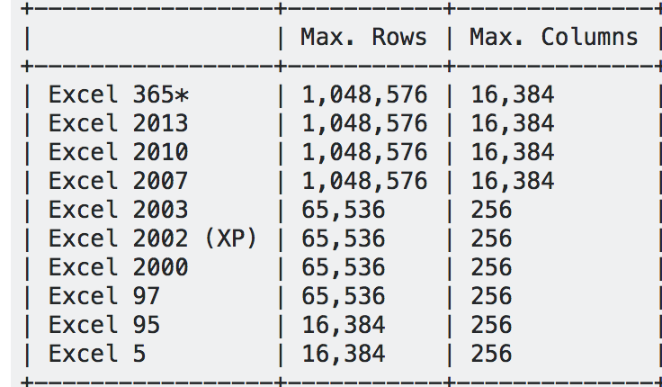
Notes:
If you have exactly this number of rows or columns, perhaps your data was actually longer but truncated.
(tangent over)

Slide 80

https://www.thisamericanlife.org/extras/canvassers-study-in-episode-555-has-been-retracted
Notes:
This is a crazy and amazing story. I’m not sure how TAL would have figured this out. But the way the researchers did is fantastic.

Slide 81
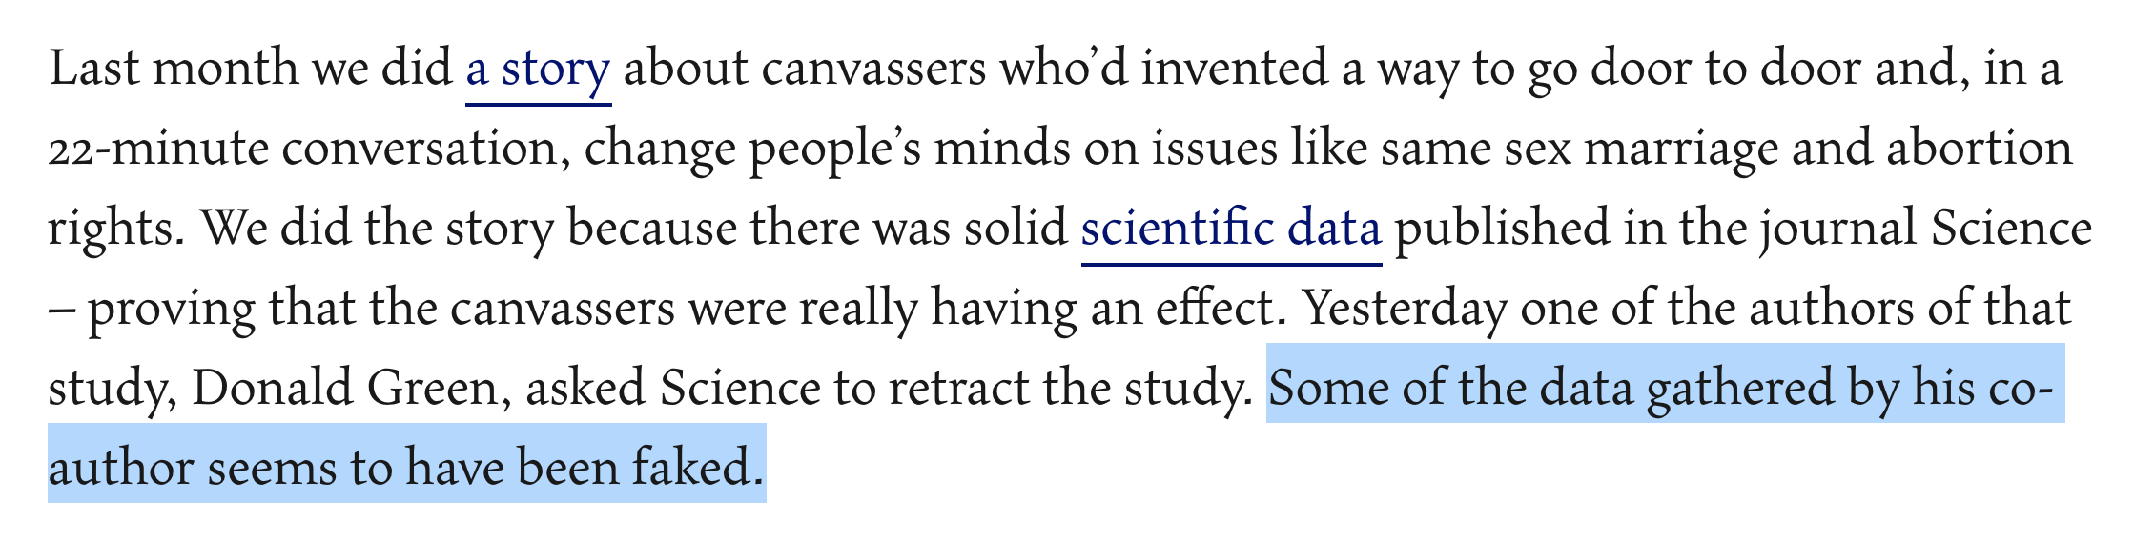

Slide 82
Notes:
The study went like this: they did an online survey, then they sent canvassers to people’s houses, then they did another survey. The result was so amazing and unexpected that some other researchers wanted to try some variations. (LeCour is the original researcher)

Slide 83
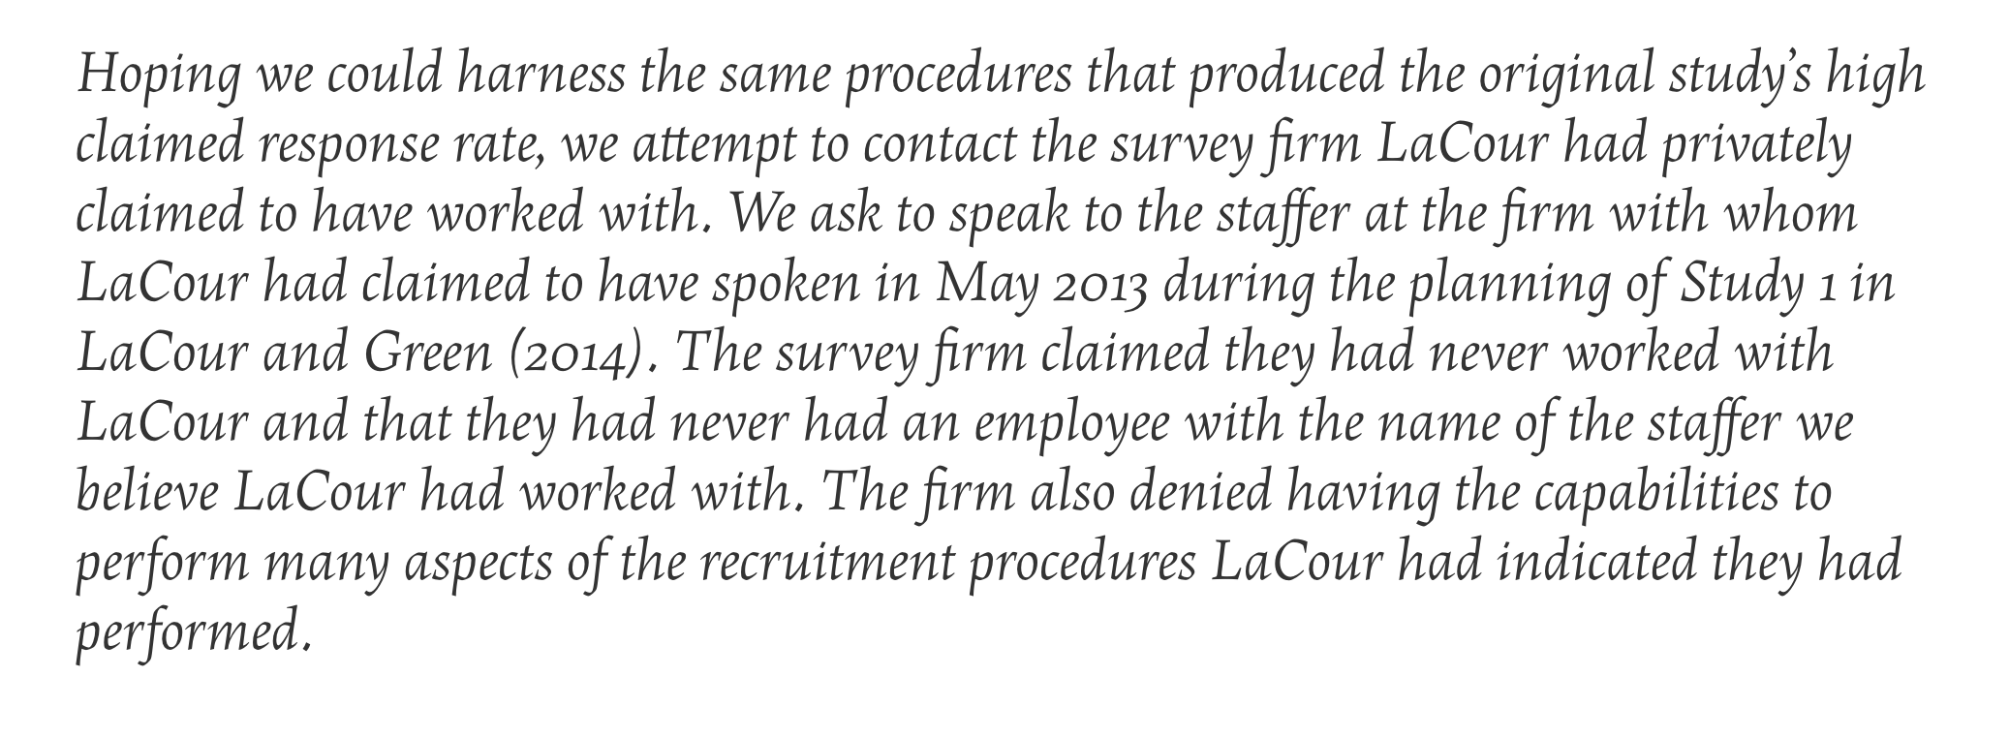
Notes:
They reported it out by calling the original source. They found a few other pieces of evidence, namely, they did some statistical analysis on the data and found that the distributions look too good to be real.
Note lots of others wrote about this data, but I like the way TAL explained it best. NYT just dumped an editor’s note at the bottom where no one will ever look.
I don’t think anyone expects this level of vetting from journalists. Before LaCour got around to fooling TAL and NYT and many others, he fooled his coauthor (who is very respected in the field) and the editors of a top scientific journal. This is just a great story about data vetting.

Slide 84
Start with a question
I said to start with a question, and then find the data.
But how realistic is that?
Notes:
So, back to where we started.
I still believe starting with a question and finding the data to answer it is the gold standard of data stories. But if we’re being realistic, it’s an impossible standard. Our questions will be influenced by the data that exists and that we know about. And like in any story, your editor will have opinions.

Slide 85
A realistic goal
Be aware of common datasets inside your beat
Pay attention to new ones
Let datasets inspire questions
And be prepared with knowledge to answer great questions that do occur to you
Notes:
So you’ll know where to go and what kinds of questions can be answered. And have responses to your editor’s data questions.

